Slide 1
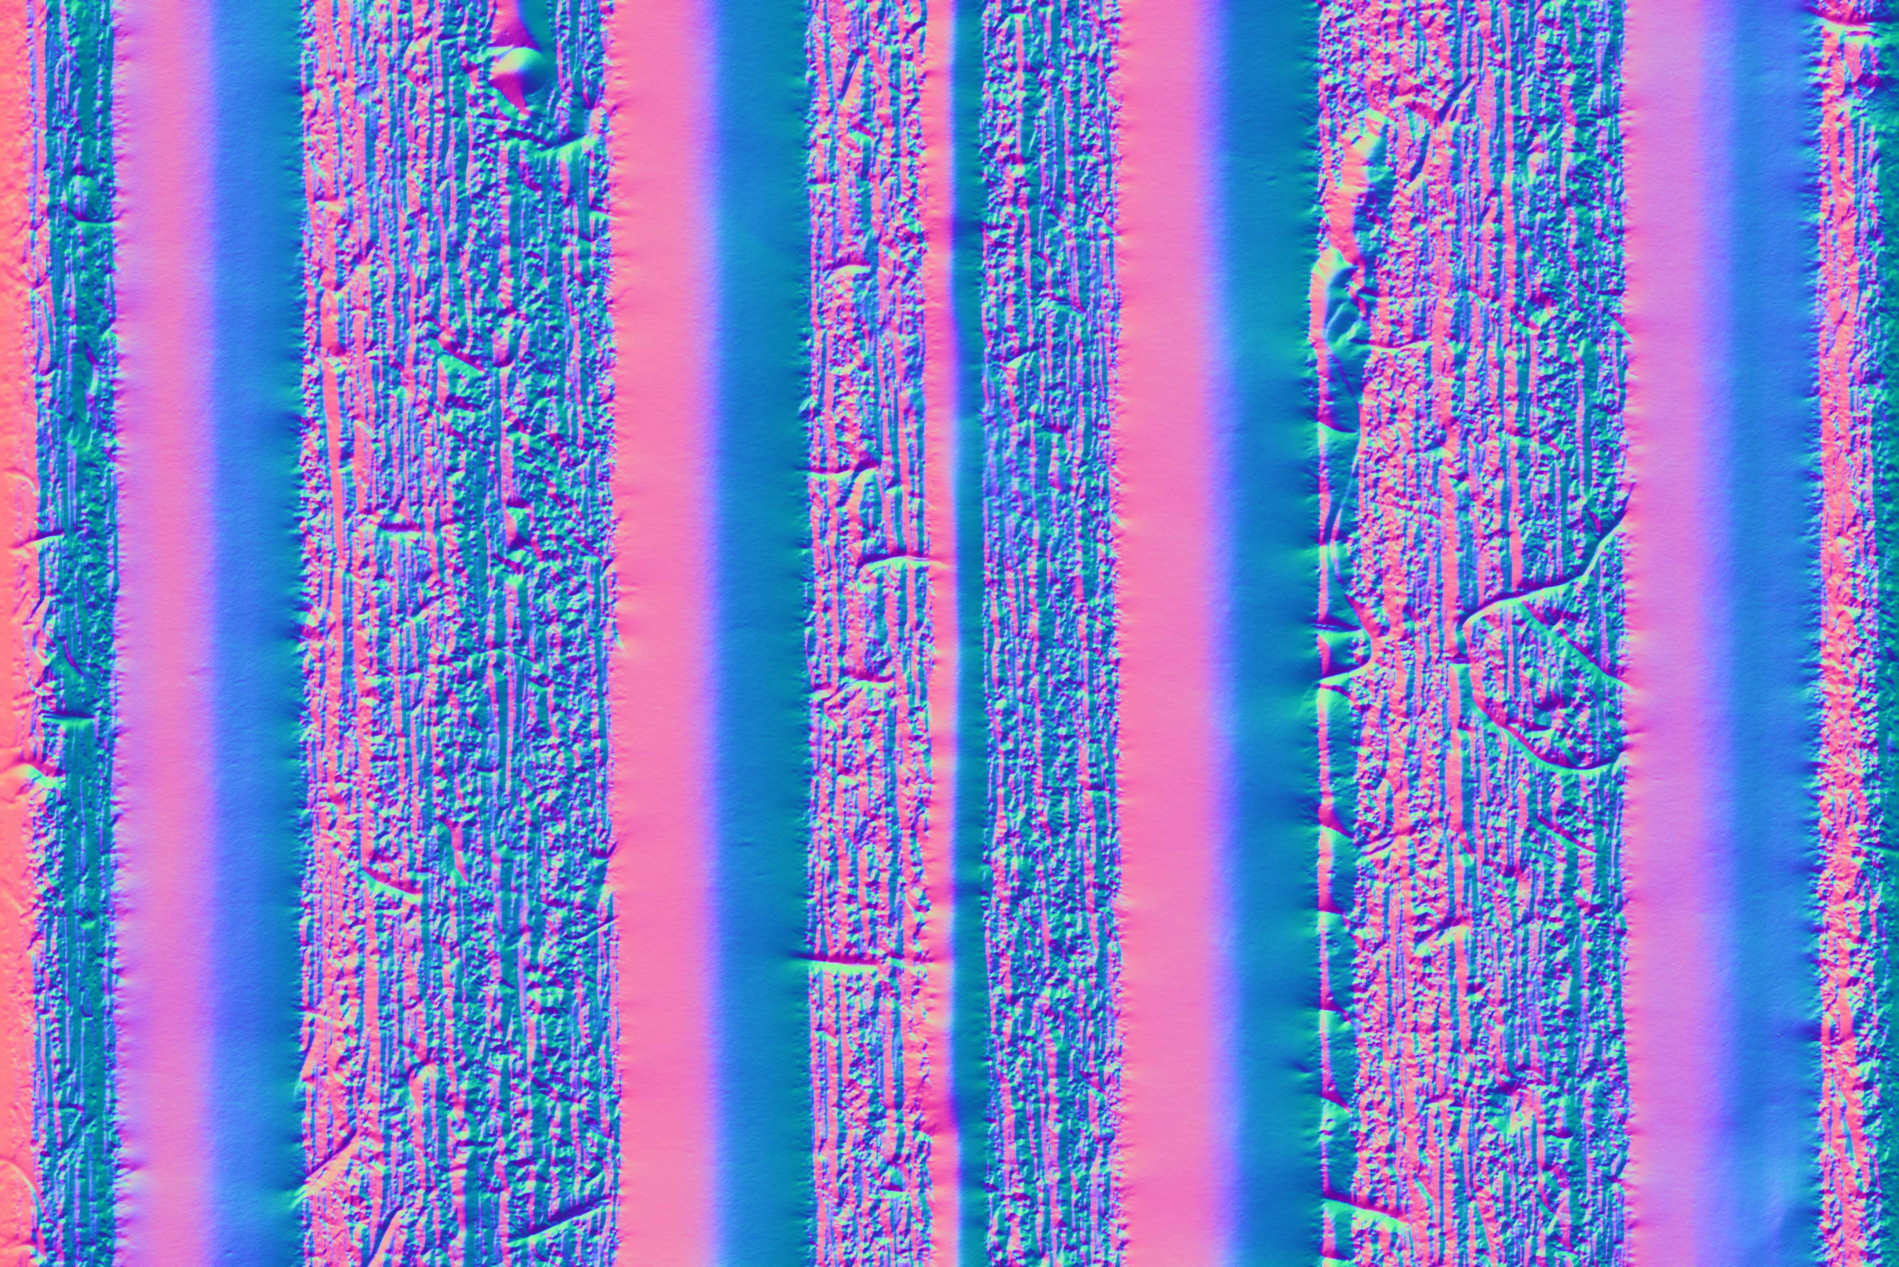
Distance: 0 mm

Slide 2

Distance: 150 mm

Slide 3
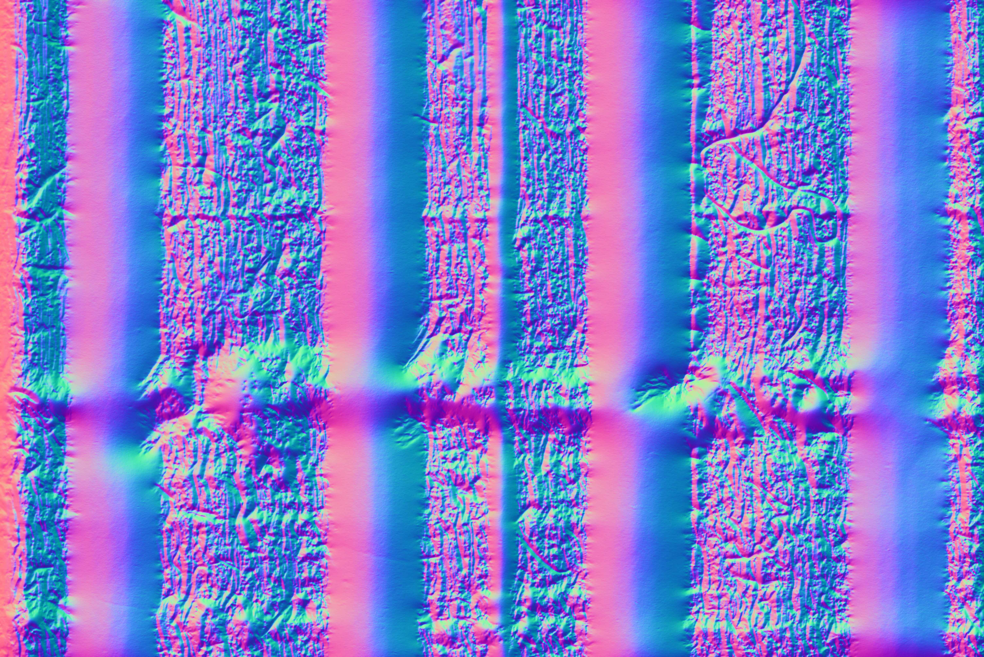
Distance: 300 mm

Slide 4
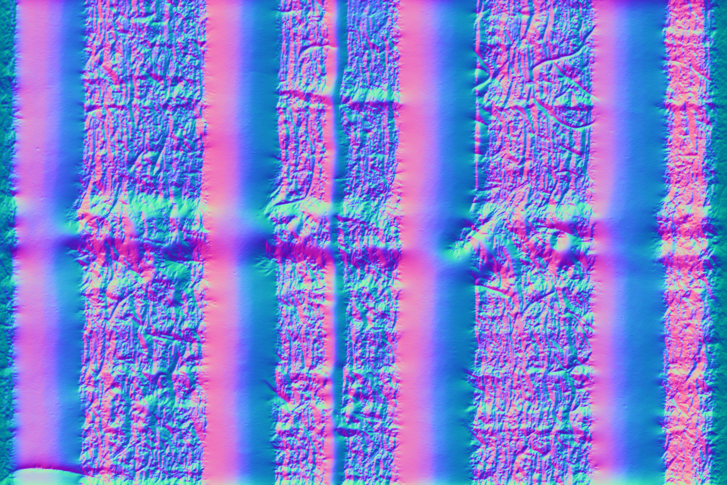
Distance: 450 mm

Slide 5
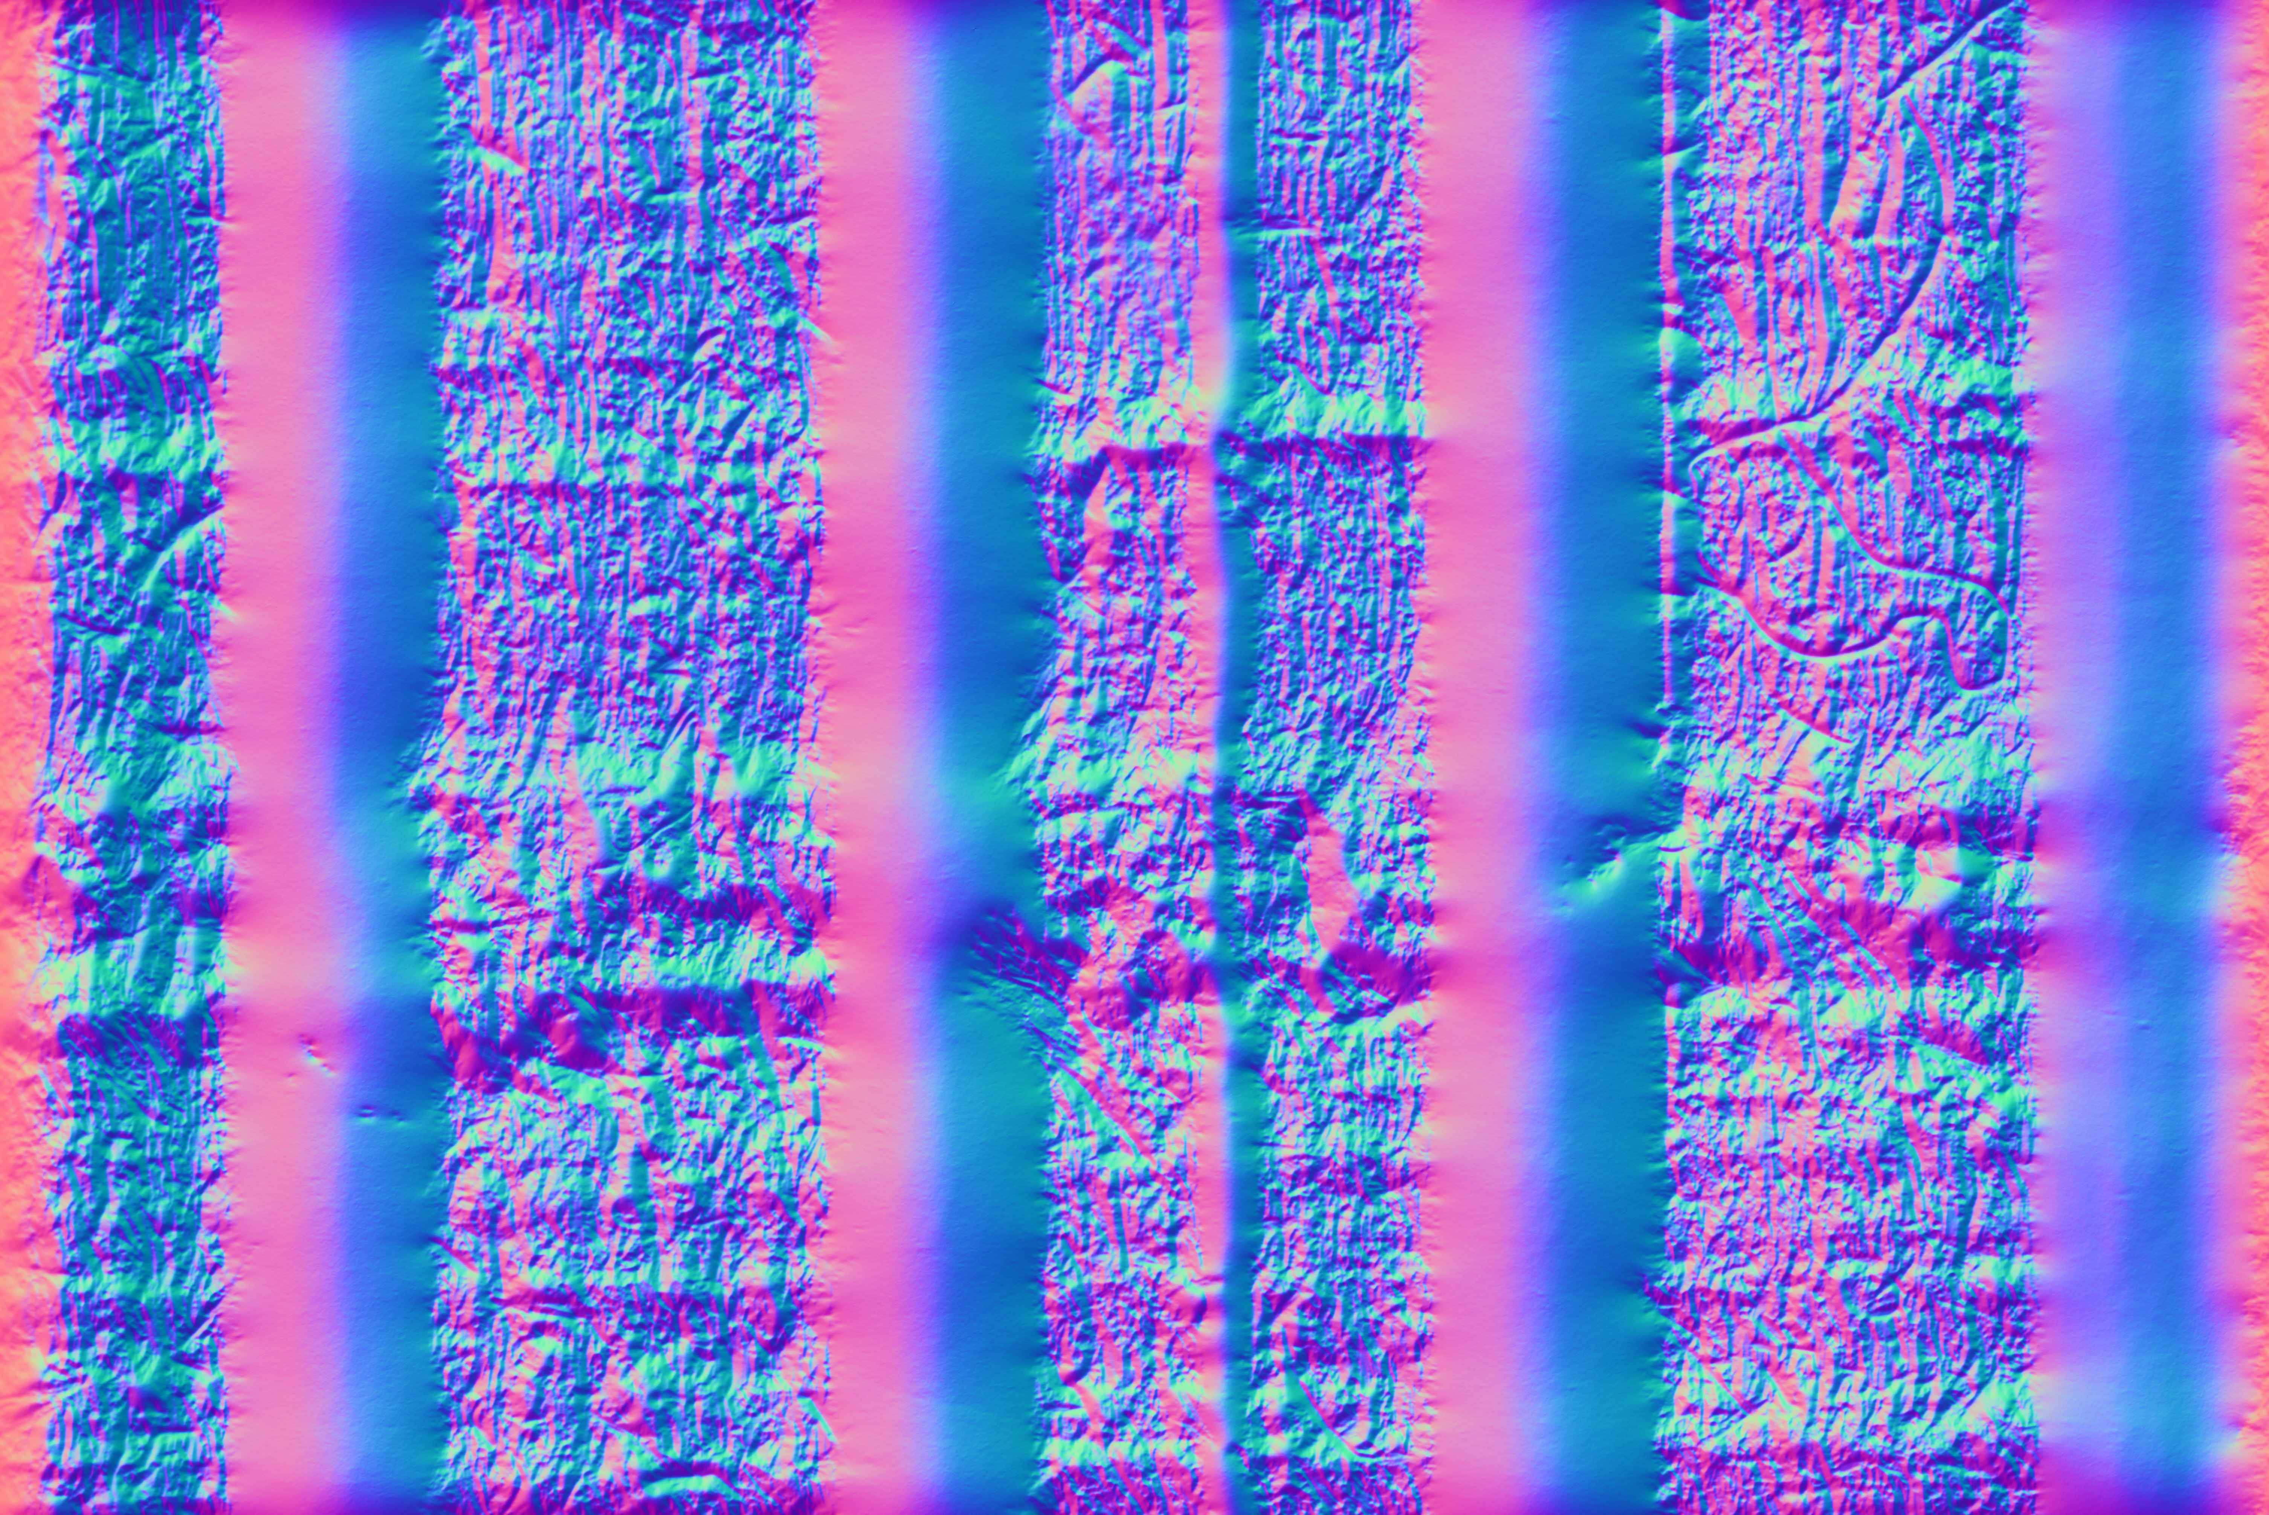
Distance: 600 mm

